Slide 1
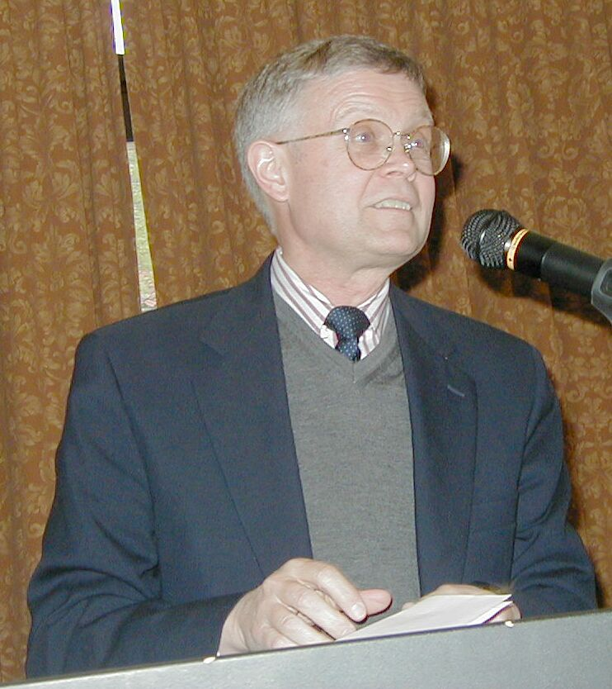
Unintended Consequences
…“we maintain that the American Revolution and the Civil War can best be understood as unanticipated consequences of decisive victories in the great imperial wars—the Seven Years’ War and the Mexican-American War—that preceded each by a little more than a decade.”
The Dominion of War: Empire and Liberty in North America 1500-2000 by Fred Anderson and Andrew Cayton, page xiii

Slide 2
What to do with the territory acquired in the Mexican-American War?

Slide 3
Four proposals
Outright exclusion
Extension of the Missouri Compromise line to the Pacific
Popular sovereignty
Protection of the property right of slaveholders (as protected under the U.S. Constitution)

Slide 4
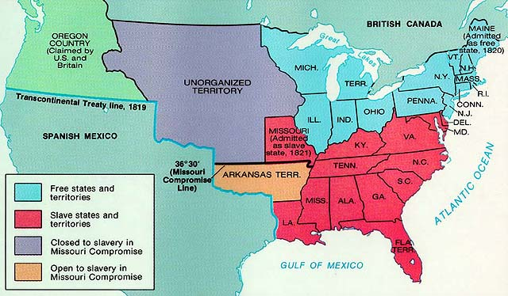
The Missouri Compromise (1820)

Slide 5
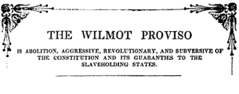
Wilmot Proviso
1
8
4
6
In 1846, Pennsylvania Congressman David Wilmot introduced an amendment (proviso) to an appropriations bill that provided for banning slavery by banning all nonwhites from any territory the United States might acquire from Mexico as a result of war.

Slide 6
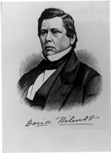
Wilmot Proviso
1
8
4
6
It never passed Congress, but the Proviso generated a great debate on the authority of the federal government to ban slavery from the territories.
Wilmot, David Wilmot was a Democratic Congressman from Pennsylvania.

Slide 7
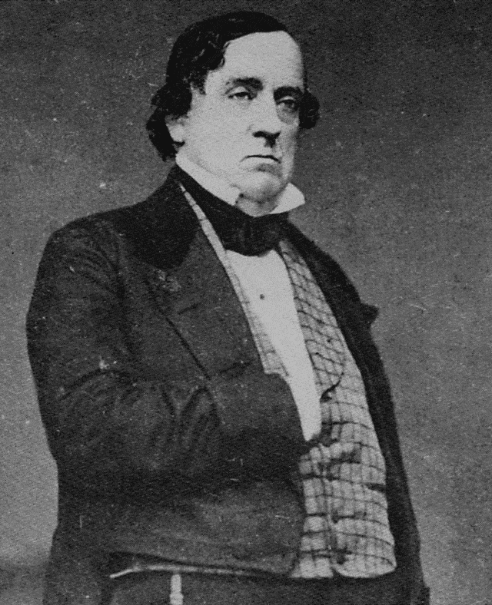
Popular Sovereignty
1
8
4
7
Proposal by Lewis Cass to let residents of the territories (not Congress) decide whether to have slavery or not (a seemingly “democratic” idea)
Lewis Cass Democrat from Michigan

Slide 8
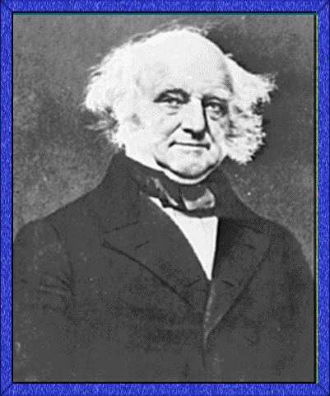
Free-Soil Party
1
8
4
8
Antislavery Northern Democrats and Northern “Conscience” Whigs joined with the abolitionist Liberty party to form the Free-Soil party, which nominated Martin Van Buren for president. The party opposed the expansion of slavery into the territories.
Martin Van Buren

Slide 9
Free-Soil Party
1
8
4
8
Slogan: “Free soil, free speech, free labor, free men”
= free “white” men
Martin Van Buren

Slide 10
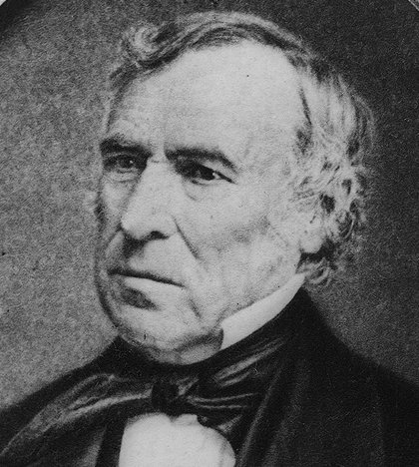
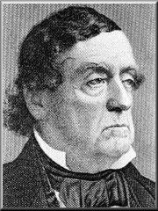
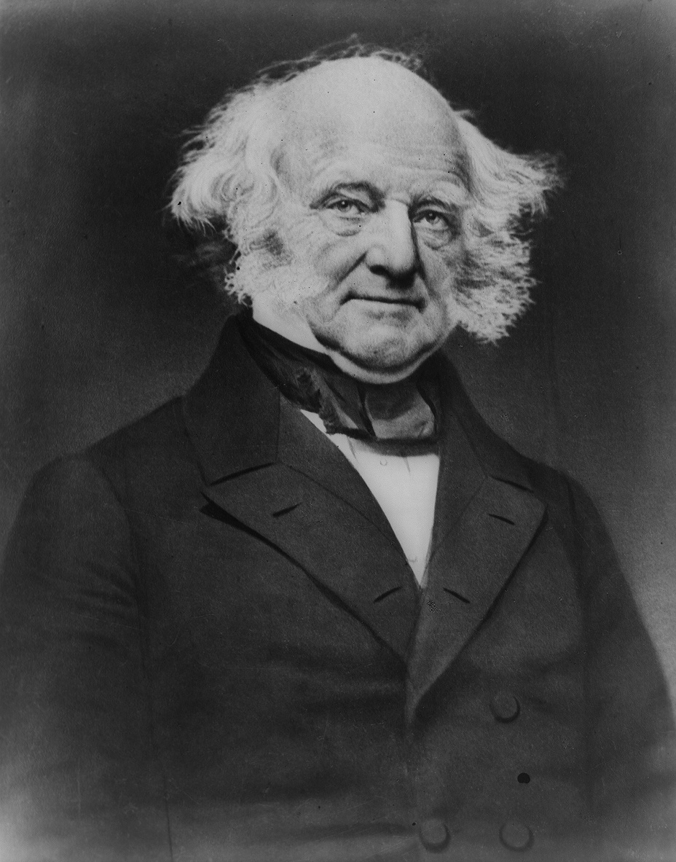
Election of 1848
General Zachary Taylor (Whig)
Lewis Cass (Democrat)
Martin Van Buren (Free Soil Party)

Slide 11
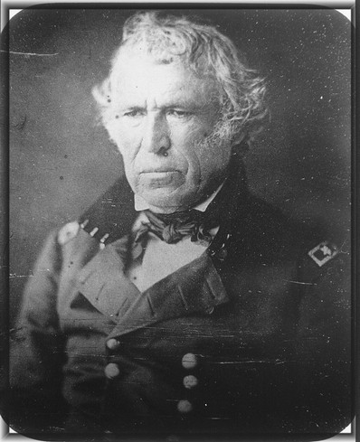
Zachary Taylor
1
8
4
8
General Taylor was the commander of American armies in northern Mexico during the Mexican War. He won the Election of 1848 as a Whig candidate. He died in office in two years later—in 1850.
Whig Party

Slide 12
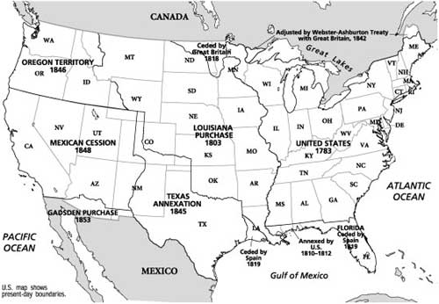
The United States in 1848

Slide 13
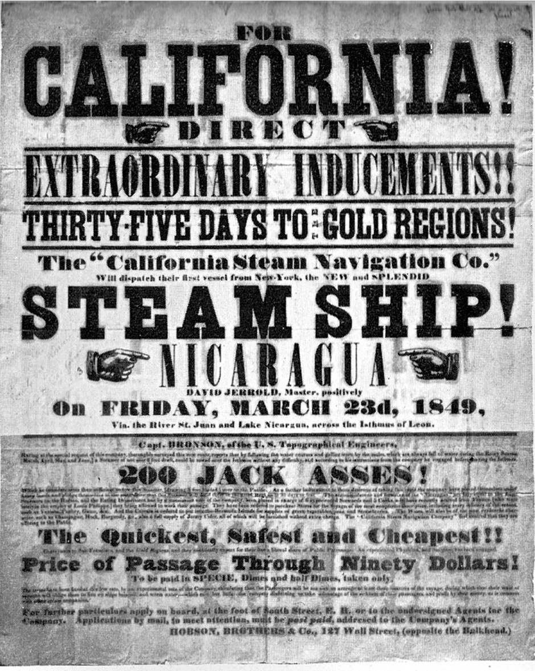
Gold in California (1848)
Gold “rush”—the “49ers”
Some free blacks
California is “free” state
“Free” = free to be white people (i.e., without black people = “whites only”)

Slide 14
What to do with California?

Slide 15
Problems
California wanted in as a “free state”
15 free states and 15 slave states in the United States Senate
California would disrupt the balance

Slide 16
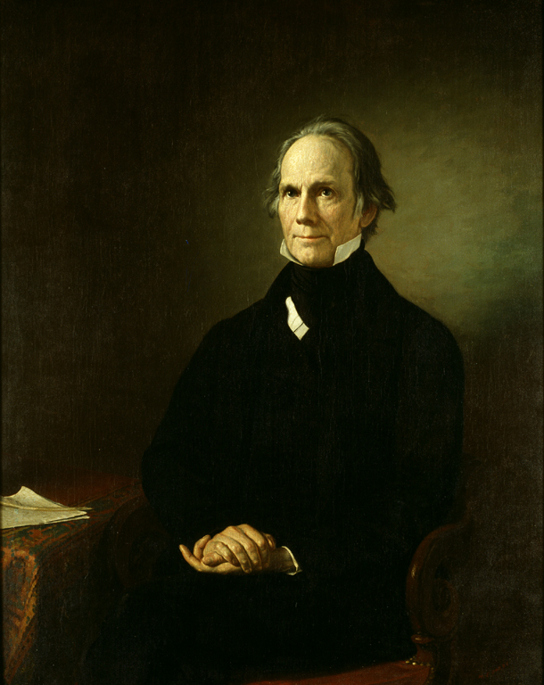
Compromise of 1850
California admitted as free state
New Mexico and Utah organized as territories (open to slavery)
Slave trade (but not slavery) abolished in DC
Stricter Fugitive slave law
Senator Henry Clay (KT)

Slide 17
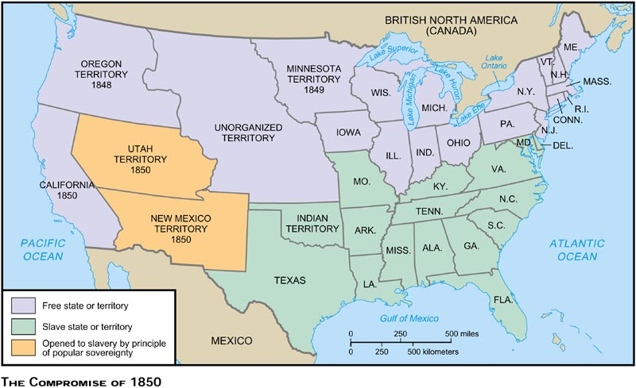
The Compromise of 1850

Slide 18
Fugitive Slave Law
1
8
5
0
Under it, federal commissioners were authorized to compel citizens to assist in the return of runaway (fugitive) slaves, and fugitives could not testify in their own behalf and were denied a jury trial.
Compromise of 1850

Slide 19
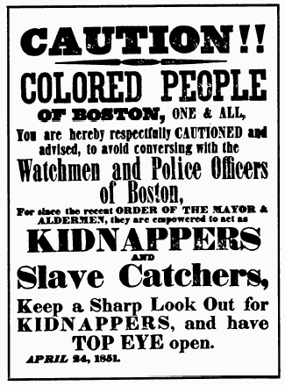

Slide 20
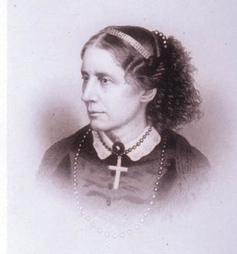
Uncle Tom’s Cabin
1
8
5
2
This book was written in response to the Fugitive Slave Act. In it, Stowe presented slaves as real people to a northern audience that was moved by the trials and tribulations of Uncle Tom and his family. Many northerners, disinterested in slavery, now began to question the justness of the "peculiar institution."
Harriet Beecher Stowe

Slide 21
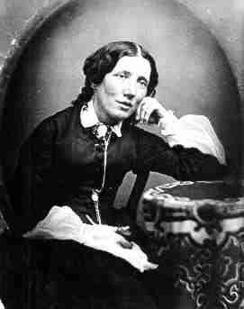
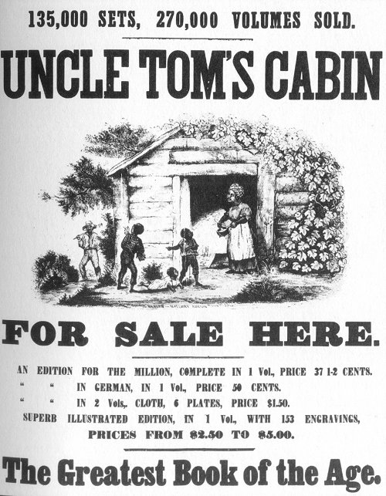
Uncle Tom’s Cabin
Harriet Beecher Stowe

Slide 22
Know-Nothing Party
1
8
5
0
s
Also known as the American party, it was a nativist, anti-immigrant, anti-Catholic political party organized in response to the 1850s flood of Catholic immigrants from Ireland and Germany. The party enjoyed some success in local and state elections in 1854 but failed to sustain its existence.
Nativism

Slide 23
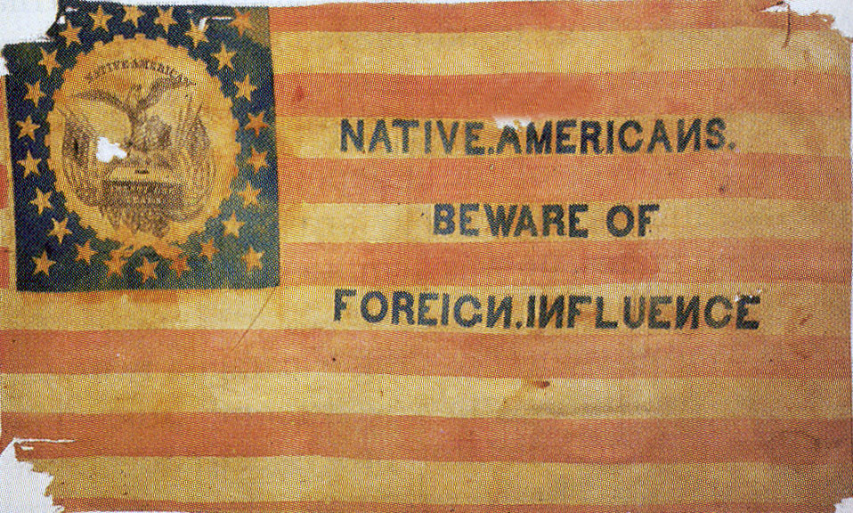

Slide 24
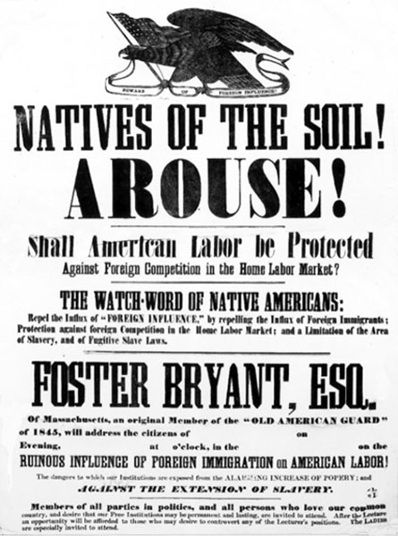

Slide 25
Ostend (Belgium) Manifesto
1
8
5
4
A confidential dispatch to the U.S. State Department from U.S. ambassadors in Europe. It suggested that if Spain refused to sell Cuba to the United States, the United States would be justified in seizing the island. Northerners claimed it was a plot to expand slavery and the manifesto was disavowed.
“Slave Power”

Slide 26
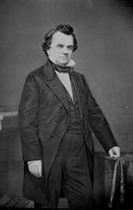
Kansas-Nebraska Act
1
8
5
4
Senator Stephen A. Douglas’s proposal to organize the remaining Louisiana Purchase Territory. Since the Missouri Compromise had banned slavery in that territory, his proposal to use popular sovereignty to determine the fate of slavery in the territory outraged northerners. The bill passed, spurring northern opponents of slavery's expansion to organize the Republican Party.
Stephen A. Douglas (D-Illinois)

Slide 27
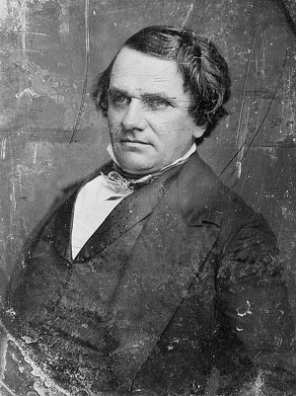
Douglas’s Compromise
Two new territories: Kansas and Nebraska
Scraps Missouri Compromise
Allows territories to decide: “popular sovereignty”

Slide 28
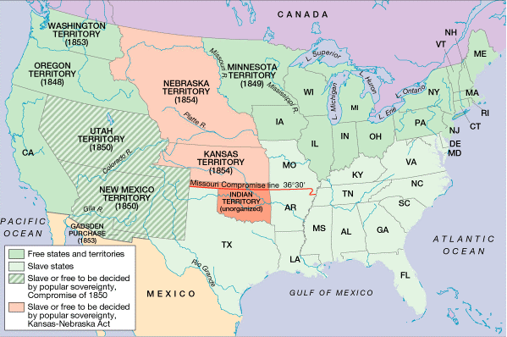
The Kansas-Nebraska Act

Slide 29
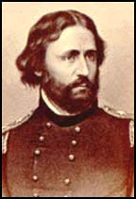
Republican Party
1
8
5
6
Organized in 1855 in response to the passage of the Kansas-Nebraska Act. A party of northern opponents of the territorial expansion of slavery, it adopted most of the Whigs' economic program. The party nominated John C. Frémont for president in 1856.
John C. Fremont

Slide 30
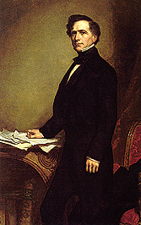
“Bleeding Kansas”
1
8
5
5
The contest between proslavery and antislavery settlers for control of Kansas Territory provoked violence and bloodshed in 1855. For partisan reasons, President Pierce's administration failed to implement popular sovereignty peacefully in "Bleeding Kansas."
Franklin Pierce (D)

Slide 31
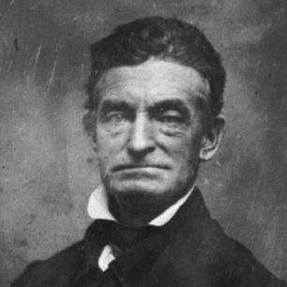
Pottawatomie Creek, Kansas
1
8
5
6
John Brown was a radical abolitionist who violently attacked slavery. He led the Pottawatomie Massacre against proslavery settlers in Kansas in 1856.
John Brown

Slide 32
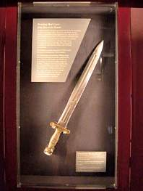
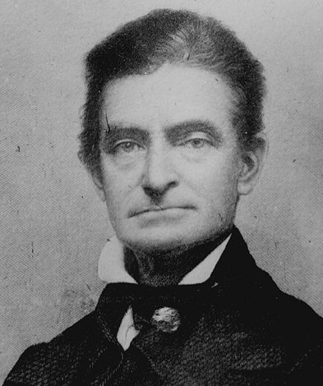
Pottawatomie Creek
John Brown

Slide 33
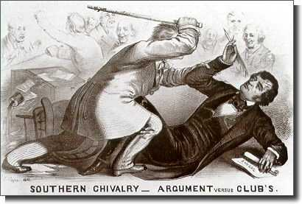
Brooks-Sumner incident
1
8
5
6
Charles Sumner was an abolitionist senator from Massachusetts who was brutally beaten by a proslavery Congressman Preston Brooks for his "Crime Against Kansas" speech, a blast against proslavery southern politicians. After the Civil War, Sumner was a leader of the Radical Republicans who demanded equal rights for freedmen.
Preston Brooks;
Charles Sumner

Slide 34
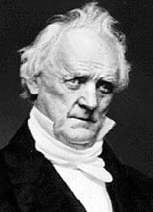
James Buchanan
1
8
5
6
An experienced diplomat and coauthor of the notorious Ostend Manifesto in 1854. He won the presidency as the nominee of the Democratic party in 1856. The Democratic party divided along North-South lines during his term.
Democrat

Slide 35
Lecompton Constitution
1
8
5
6
The Lecompton (Kansas) constitution was a fraudulently adopted proslavery constitution that Kansas presented with its request for statehood in 1856, generating a controversy that divided the Democratic party. Congress eventually rejected it. (Kansas was admitted as a free state in 1861.)
Kansas

Slide 36
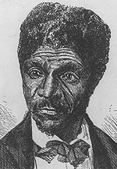
Dred Scott Case
Was Dred Scott a citizen?
Did his time in Wisconsin make him free?
Did Congress have any power to restrict slavery?
Dred Scott

Slide 37
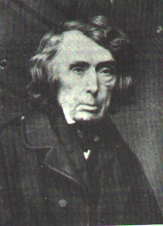
Dred Scott Decision
African-Americans are not citizens
Scott remains a slave under Missouri law
Congress cannot ban slavery in any territory
The Missouri Compromise is unconstitutional
Judge Roger Taney

Slide 38
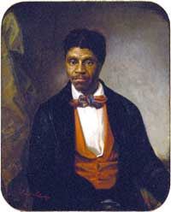

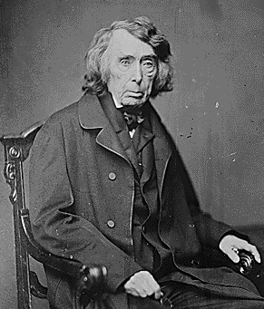
Dred Scott v. Sanford
1
8
5
7
The Supreme Court ruled that blacks were not citizens and could not sue in a federal court, and that Congress had no constitutional authority to ban slavery from a territory—that, in effect, the Missouri Compromise was unconstitutional. The decision threatened both the central plank of the Republican party, Free-Soil, and the concept of popular sovereignty.
Roger B. Taney

Slide 39

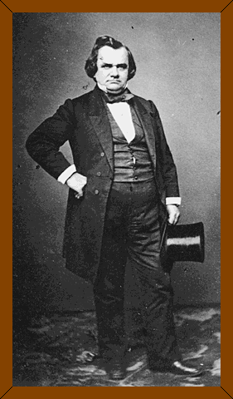
Lincoln-Douglas Debates
“A house divided against itself cannot stand. I believe this government cannot endure permanently half slave and half free.”
"Little Giant"
"Long Abe"

Slide 40
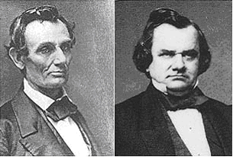
Lincoln-Douglas Debates
1
8
5
8
In the Senate race in Illinois in 1858, Senator Stephen Douglas and Republican Abraham Lincoln engaged in a series of debates, which focused on the implications of the Dred Scott decision and the future of slavery in America. Lincoln won wide acclaim in the North for his views. Douglas, however, won reelection.
“Freeport Doctrine”

Slide 41
Freeport Doctrine
1
8
5
8
During the Lincoln-Douglas debates, Douglas declared that, even in the face of the "Dred Scott" decision, the people of a territory could exclude slavery simply by not passing the local ordinances essential for holding blacks in bondage. This Freeport Doctrine helped Douglas win reelection to the Senate, but, because it angered proslavery southern Democrats, it hurt his bid for the Democratic party's presidential nomination in 1860.
Stephen Douglas

Slide 42
Harper’s Ferry Raid
1
8
5
9
Abolitionist John Brown and his followers raided the federal arsenal at Harpers Ferry, Virginia. Brown planned to arm local slaves, lead an armed rebellion, and establish a black republic. Brown was arrested, tried for treason, and executed. He became a martyr in the eyes of northern abolitionists
John Brown

Slide 43
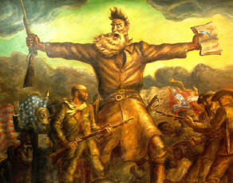
Harper’s Ferry
John Brown

Slide 44
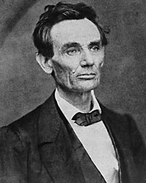
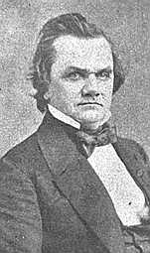
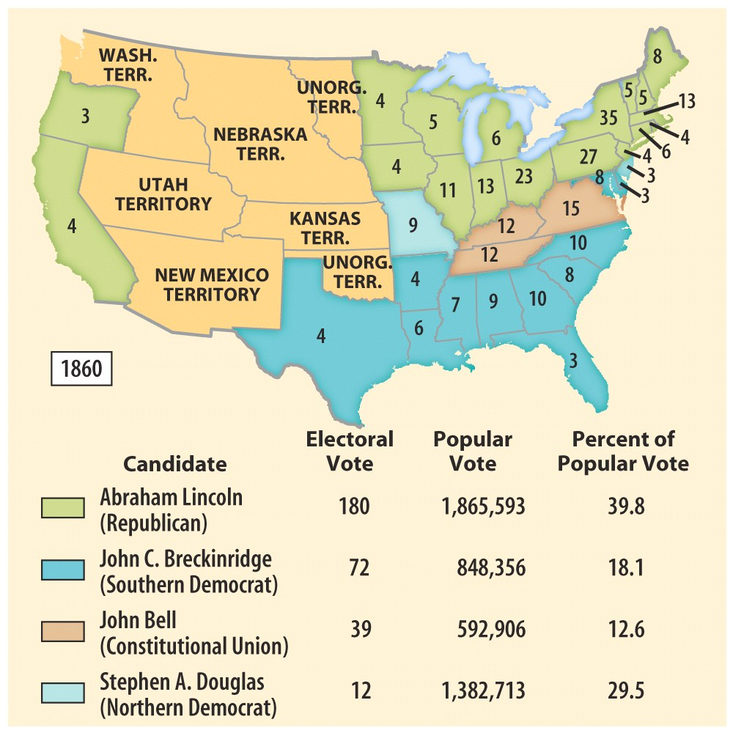
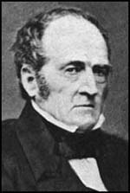
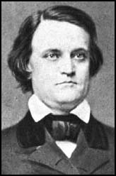
Election of 1860
Lincoln
Douglas
Bell
Breckinridge

Slide 45
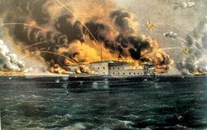
Fort Sumter

Slide 46
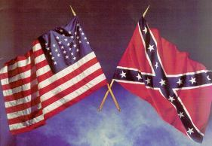
Thus the Civil War began…

